Slide 1
INDEX
Exception Handling

Slide 2
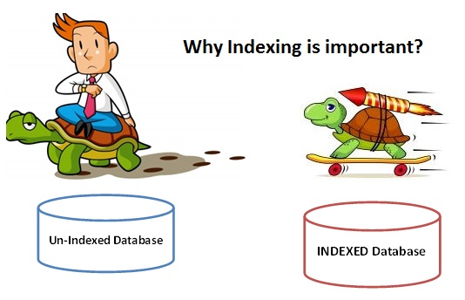
What are Index?
Nobody likes slow systems.
High system performance is of prime importance in almost all database systems .
Most businesses invest heavily in hardware so that data retrievals and manipulations can be faster.
But there is limit to hardware investments a business can make.
Optimizing your database is a cheaper and better solution.
Towards this end we can use INDEXES.

Slide 3
An index is used to speed up searching in the database.
An index can be used to efficiently find all row matching some column in your query and then walk through only that subset of the table to find exact matches.
If you don't have indexes on any column in the WHERE clause,
  the SQL server have to walk through the whole table and check every row to see if it matches, which may be a slow operation on big tables.
The index can also be a UNIQUE index, which means that you cannot have duplicate values in that column, or a PRIMARY KEY which in some storage engines defines where in the database file the value is stored.
Notes:
very good analogy is to think of a database index as an index in a book. If you have a book regarding countries and you are looking for India, then why would you flip through the entire book – which is the equivalent of a full table scan in database terminology – when you can just go to the index at the back of the book, which will tell you the exact pages where you can find information on India. Similarly, as a book index contains a page number, a database index contains a pointer to the row containing the value that you are searching for in your SQL.

Slide 4
MySQL uses indexes for these operations
To find the rows matching a WHERE clause quickly.
To eliminate rows from consideration. If there is a choice between multiple indexes, MySQL normally uses the index that finds the smallest number of rows (the most selective index).
If the table has a multiple-column index,any leftmost prefix of the index can be used by the optimizer to look up rows.
-For example, if you have a three-column index on (col1, col2, col3),
  you have indexed search capabilities on (col1), (col1, col2), and (col1, col2, col3).

Slide 5
SQL INDEX Types
CREATE INDEX statement to create indexes on a table. following 3 type indexes you are create on a table.
Simple INDEX : Create INDEX on one column.
Composite INDEX : Create INDEX on multiple columns.
Unique INDEX : Create INDEX on column for restrict duplicate values on INDEX column.
Simple INDEX
Simple INDEX create only one selected column of the database table. Syntax CREATE INDEX index_name ON table_name (column_name) [ storage_setting ]; Storage setting specifies the table space explicitly. This are the optional storage setting if you are not specifies automatically default storage setting used.
Example SQL> CREATE INDEX index_user_name ON userinfo (name); We are creating simple index on name column of the userinfo table. In this column allow duplicate values of the column.

Slide 6
Composite INDEX
Composite INDEX create on multiple selected column of the database table.
Syntax
CREATE INDEX index_name ON table_name (column_name, column_name) [ storage_setting ];
Example
SQL> CREATE INDEX index_userinfo ON userinfo (no, name);
We are creating composite index on no, name column of the userinfo table.
Duplicate values are allowing for creating indexes.

Slide 7
Unique INDEX
Unique INDEX create on selected column of the database table and does not allow duplicate values of that indexes column.
Syntax
CREATE UNIQUE INDEX index_name ON table_name (column_name) [ storage_setting ];
Example
SQL> CREATE UNIQUE INDEX index_user_name ON userinfo (name);
We are create unique index on name column of the userinfo table. Duplicate name value are does not allow again for creating indexes.

Slide 8
RENAME INDEX
Syntax
ALTER INDEX index_name RENAME TO new_index_name;
Example
SQL> ALTER INDEX user_name RENAME TO index_username;
We are renaming the above created index name index_user_name to a new index name index_username.
DROP INDEX
Syntax
DROP INDEX index_name;
Example
SQL> DROP INDEX index_username;
In this statement we are dropping index_username INDEX.

Slide 9
Column Indexes
The most common type of index involves a single column, storing copies of the values from that column in a data structure, allowing fast lookups for the rows with the corresponding column values. The B-tree data structure lets the index quickly find a specific value, a set of values, or a range of values, corresponding to operators such as =, >, ≤, BETWEEN, IN, and so on, in a WHERE clause.
The maximum number of indexes per table and the maximum index length is defined per storage engine
  Updating a table with indexes takes more time than updating a table without (because the indexes also need an update). So, only create indexes on columns that will be frequently searched against

Slide 10
syntax
CREATE INDEX index_name
ON table_name (column1, column2, ...);
CREATE INDEX idx_lastname
ON Persons (LastName);
If you want to create an index on a combination of columns, you can list the column names within the parentheses, separated by commas:
CREATE INDEX idx_pname
ON Persons (LastName, FirstName);

Slide 11
Queries
Another consideration when setting up indexes is how the database will be queried.
As mentioned above, you must take into account the frequency of data modifications:
Try to insert or modify as many rows as possible in a single statement, rather than using multiple queries.
Create nonclustered indexes on columns used frequently in your statement’s predicates and join conditions.
Consider indexing columns used in exact-match queries.

Slide 12
The design and implementation of indexes are an important component of any SQL Server database design, not only in terms of what should be indexed,
  but where those indexes should be stored, how they should be partitioned,
  how data will be queried, and other important considerations.

Slide 13
PL/SQL exceptions
PL/SQL exceptions are predefined and raised automatically into oracle engine when any error occur during a program.
Each and every error has defined a unique number and message.
When warning/error occur in program it's called an exception to contains information about the error.
In PL/SQL built in exceptions or you make user define exception. Examples of built-in type (internally) defined exceptions division by zero, out of memory.
  Some common built-in exceptions have predefined names such as ZERO_DIVIDE and STORAGE_ERROR.
  Normally when exception is fire, execution stops and control transfers to the exception-handling part of your PL/SQL block.
  Internal exceptions are raised implicitly (automatically) by the run-time system. User-defined exceptions must be raised explicitly by RAISE statements, which are also raise predefined exceptions.
PL/SQL exceptions consist following three,
Exception Type
Error Code
Error Messag

Slide 14
DECLARE declaration statement(s); BEGIN statement(s); EXCEPTION WHEN built-in_exception_name_1 THEN User defined statement (action) will be taken; WHEN built-in_exception_name_2 THEN User defined statement (action) will be taken; END;
Example SQL>edit buitin_exp DECLARE temp enum%rowtype; BEGIN SELECT * INTO temp FROM enum WHERE eno=3; EXCEPTION WHEN no_data_found THEN dbms_output.put_line("Table haven't data"); END; /
Result
SQL>@buitin_exp
Table haven't data
PL/SQL procedure successfully operation.

Slide 15
PL/SQL built in exceptions
Following are built in type exception,
Exception | Error Code | Description
ACCESS_INTO_NULL | ORA-06530 | Exception raised when assign uninitialized (NULL) object.
CASE_NOT_FOUND | ORA-06592 | Exception raised when no any choice case found in CASE statement as well as no ELSE clause in CASE statement.
CURSOR_ALREADY_OPEN | ORA-06511 | Exception raised when you open a cursor that is already opened.
DUP_VAL_ON_INDEX | ORA-00001 | Exception raised when you store duplicate value in unique constraint column.
INVALID_CURSOR | ORA-01001 | Exception raised when you perform operation on cursor and cursor is not really opened.
INVALID_NUMBER | ORA-01722 | Exception raised when you try to explicitly conversion from string to a number fail.
LOGIN_DENIED | ORA-01017 | Exception raised when log in into oracle with wrong username or password.

Slide 16
NO_DATA_FOUND | ORA-01403 | Exception raised when SELECT ... INTO statement doesn't fetch any row from a database table.
NOT_LOGGED_ON | ORA-01012 | Exception raised when your program try to get data from database and actually user not connected to Oracle.
PROGRAM_ERROR | ORA-06501 | Exception raised when your program is error prone (internal error).
STORAGE_ERROR | ORA-06500 | Exception raised when PL/SQL program runs out of memory or may be memory is dumped/corrupted.
SYS_INVALID_ROWID | ORA-01410 | Exception raised when you try to explicitly conversion from string character string to a universal rowid (uid) fail.
TIMEOUT_ON_RESOURCE | ORA-00051 | Exception raised when database is locked or ORACLE is waiting for a resource.
TOO_MANY_ROWS | ORA-01422 | Exception raised when SELECT ... INTO statement returns more than one row.
VALUE_ERROR | ORA-06502 | Exception raised when arithmetic, conversion, defined size constraint error occurs.
ZERO_DIVIDE | ORA-01476 | Exception raised when you program try to attempt divide by zero number.

Slide 17
PL/SQL User Defined Exception
PL/SQL user defined exception to make your own exception. PL/SQL give you control to make your own exception base on oracle rules. User define exception must be declare yourself and RAISE statement to raise explicitly.
RAISE exception
RAISE statement to raised defined exception name and control transfer to a EXCEPTION block.
RAISE user_define_exception_name;
Implement exception condition
In PL/SQL EXCEPTION block add WHEN condition to implement user define action.
WHEN user_define_exception_name THEN User defined statement (action) will be taken;

Slide 18
Syntax
Check this user defined exception syntax,
DECLARE user_define_exception_name EXCEPTION;
BEGIN statement(s);
IF condition THEN RAISE user_define_exception_name;
END IF;
EXCEPTION WHEN user_define_exception_name THEN User defined statement (action) will be taken;
END;
Example
user_exp.sql
SQL>edit user_exp DECLARE myex EXCEPTION;
i NUMBER;
BEGIN
FOR i IN (SELECT * FROM enum)
LOOP IF i.eno = 3 THEN RAISE myex;
END IF;
END LOOP;
EXCEPTION WHEN myex THEN dbms_output.put.line('Employee number already exist in enum table.');
END; /
Result
SQL>@user_exp
Employee number already exist in enum table.
PL/SQL procedure successfully operation.

Slide 19
PL/SQL User Named Exception PRAGMA EXCEPTION_INIT, RAISE_APPLICATION_ERROR

Slide 21
SQL
Query Optimization is the process of writing the query in a way so that it could execute quickly. It is a significant step for any standard application.
Sql Statements are used to retrieve data from the database. We can get same results by writing different sql queries.
But use of the best query is important when performance is considered. So you need to sql query tuning based on the requirement which we use reqularly and how these sql queries can be optimized for better performance.

Slide 22
Some tips to improve the performance of SQL queries?
Optimizing SQL queries can bring substantial positive impact on the performance. It also depends on the level of RDBMS knowledge.
  1. Prefer to use views and stored procedures in spite of writing long queries. It’ll also help in minimizing network load.
  2. It’s better to introduce constraints instead of triggers. They are more efficient than triggers and can increase performance.
  3. Make use of table-level variables instead of temporary tables.
  4. The UNION ALL clause responds faster than UNION. It doesn’t look for duplicate rows whereas the UNION statement does that regardless of whether they exist or not.
  5. Prevent the usage of DISTINCT and HAVING clauses.
  6. Avoid excessive use of SQL cursors.
  7. It’s a good practice to return the required column instead of all the columns of a table.
  8. Prefer not to use complex joins and avoid disproportionate use of triggers.
  9. Create indexes for tables and adhere to the standards.

Slide 23
SQL Tuning/SQL Optimization Techniques:
1) The sql query becomes faster if you use the actual columns names in SELECT statement instead of than '*'.
For Example: Write the query as
SELECT id, first_name, last_name, age, subject FROM student_details
Instead of:
SELECT * FROM student_details;

Slide 24
HAVING clause is used to filter the rows after all the rows are selected. It is just like a filter. Do not use HAVING clause for any other purposes.
For Example: Write the query as
SELECT subject, count(subject)
FROM student_details
WHERE subject != 'Science'
AND subject != 'Maths'
GROUP BY subject;
Instead of:
SELECT subject, count(subject)
FROM student_details
GROUP BY subject
HAVING subject!= 'Vancouver' AND subject!= 'Toronto';

Slide 25
Oracle supports a large variety of processing techniques in its query processing engine.Some of the more important ones are as follows:
Execution Methods
Data can be accessed through a variety of access methods:
Full table scan.
The query processor scans the entire table by getting information about the blocks that make up the table from the extent map, and scanning those blocks.
Index scan.
The processor creates a start and/or stop key from conditions in the query and uses it to scan to a relevant part of the index.
If there are columns that need to be retrieved, that are not part of the index, the index scan would be followed by a table access by index row-id. If no start or stop key is available, the scan would be a full index scan.

Slide 26
Index fast full scan
The processor scans the extents the same way as the table extent in a full table scan.
If the index contains all the columns that are needed in the index, and there are no good start/stop keys that would significantly reduce that portion of the index that would be scanned in a regular index scan, this method may be the fastest way to access the data. This is because the fast full scan can take full advantage of multiblock disk I/O.
However, unlike a regular full scan, which traverses the index leaf blocks in order, a fast full scan does not guarantee that the output preserves the sort order of the index.
Index join.
If a query needs only a small subset of the columns of a wide table, but no single index contains all those columns, the processor can use an index join to generate the relevant information without accessing the table, by joining several indices that together contain the needed columns. It performs the joins as hash joins on the row-ids from the different indices.
Cluster and hash cluster access. The processor accesses the data by using the cluster key.

Slide 27
Oracle has several ways to combine information from multiple indices in a single access path.
This ability allows multiple where-clause conditions to be used together to compute the result set as efficiently as possible.
The functionality includes the ability to perform Boolean operations and, or, and minus on bitmaps representing row-ids.
There are also operators that map a list of row-ids into bitmaps and viceversa, which allows regular B-tree indices and bitmap indices to be used together in the same access path.
In addition, for many queries involving count(*) on selections on a table, the result can be computed by just counting the bits that are set in the bitmap generated by applying the where clause conditions, without accessing the table.
Oracle supports several types of joins in the execution engine: inner joins, outer joins, semijoins, and antijoins.
(An antijoin in Oracle returns rows from the left-hand side input that do not match any row in the right-hand side input; this operation is called anti-semijoin in other literature.)
It evaluates each type of join by one of three methods: hash join, sort–merge join, or nested-loop join.

Slide 28
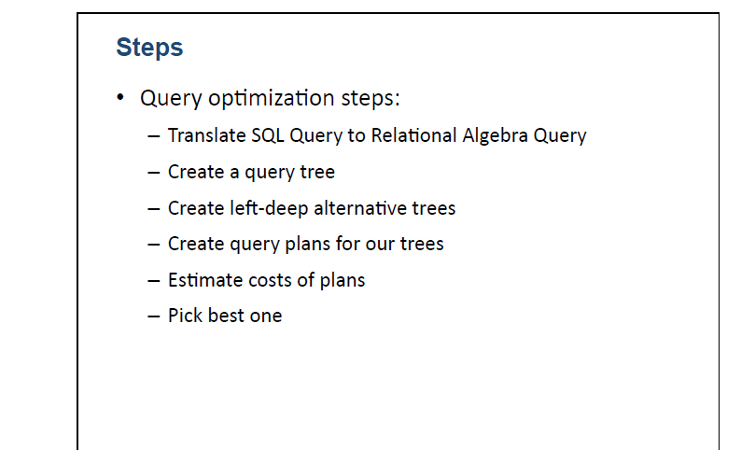
Query Transformations
Oracle does query optimization in several stages. Most of the techniques relating to query transformations and rewrites take place before access path selection, but Oracle also supports several types of cost-based query transformations that generate a complete plan and return a cost estimate for both a standard version of the query and
one that has been subjected to advanced transformations. Not all query transformation techniques are guaranteed to be beneficial for every query, but by generating a cost estimate for the best plan with and without the transformation applied, Oracle is able to make an intelligent decision.
Some of the major types of transformations and rewrites supported by Oracle are
as follows:
View merging. A view reference in a query is replaced by the view definition.
This transformation is not applicable to all views.
Complex view merging. Oracle offers this feature for certain classes of views
that are not subject to regular view merging because they have a group by or
select distinct in the view definition. If such a view is joined to other tables,
Oracle can commute the joins and the sort operation used for the group by or distinct.
•Subquery flattening. Oracle has a variety of transformations that convert various
classes of subqueries into joins, semijoins, or antijoins

Slide 29
When a query is placed, it is at first scanned, parsed and validated.
An internal representation of the query is then created such as a query tree or a query graph.
  Then alternative execution strategies are devised for retrieving results from the database tables.
  The process of choosing the most appropriate execution strategy for query processing is called query optimization.

Slide 30
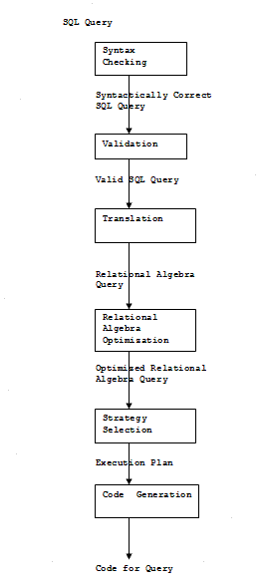
Validate query-checks data dictionary; verifies objects referred to are database objects and requested operations are valid
Translate query into relational algebra operations
Rearrange relational algebra operations into most efficient form
Use data on table sizes, indexes, order of tuples, distribution of values,
to determine how the query will be processed:
  Estimate the "cost" of alternatives and choose the plan with the least estimated cost
Consider the number of disk accesses, amount of memory, processing time, and communication costs, if any
Execution plan is then coded and executed

Slide 31
Relational Algebra Translation
SQL Select..From..Where command usually translates into combination of relational algebra SELECT, PROJECT, JOIN
SELECT-unary operator: σ_{p}(table-name)
p is a predicate, called the θ (theta) condition
Returns entire rows that satisfy θ
PROJECT-unary operator: Π_{proj-list}(table-name)
Proj-list is a list of columns
Returns unique combinations of values for those columns
JOIN-binary operator: table1 table2
Compares table1 and table2, which have a common column (or columns with same domain)
Chooses rows from each that match on common column Combines those rows, but shows common column only once

Slide 32
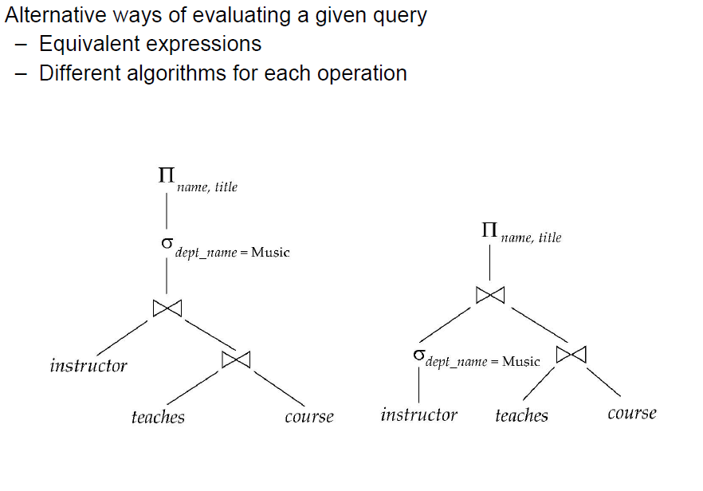

Slide 33
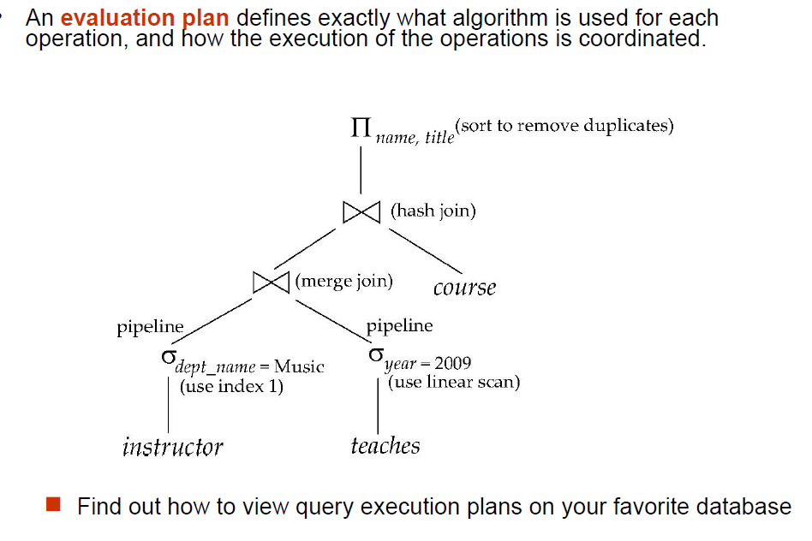

Slide 34
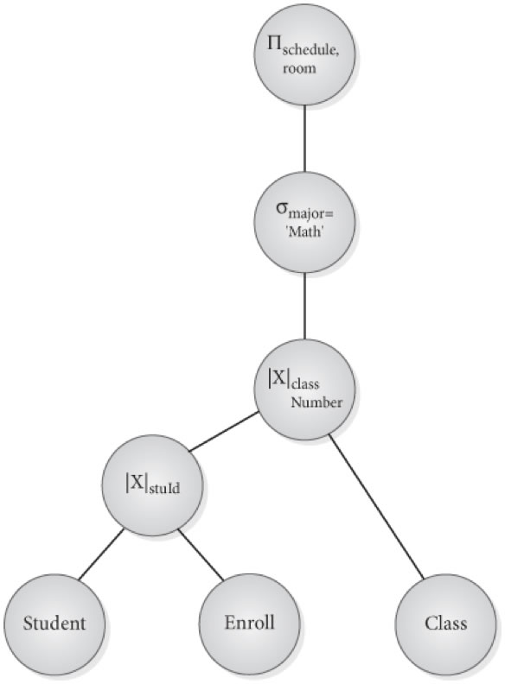
SELECT schedule, room FROM Student NATURAL JOIN Enroll NATURAL JOIN Class WHERE Major='Math’.
Graphical representation of the operations and operands in the relational algebra expression Leaf nodes are relations
Unary or binary operations are internal nodes (one child or two, respectively)
An internal node can be executed when its operands are available (children relation has been computed)
Node is replaced by the result of the operation it represents
Root node is executed last, and is replaced by the result of the entire tree

Slide 35
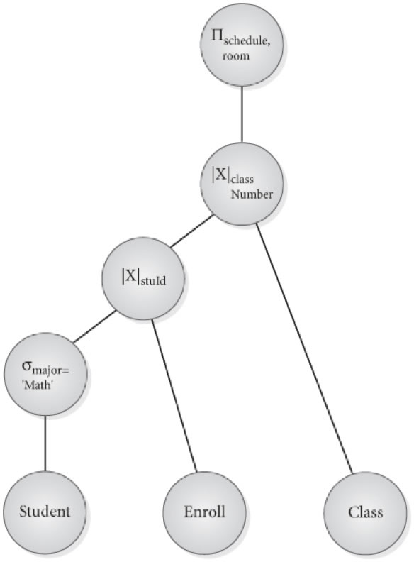
Doing SELECT early Same SQL statement can be translated to different relational algebra statements Performing SELECT early reduces size of intermediate nodes
Push SELECT as far down the tree as possible For conjunctive SELECT, do each part on its own tree instead of waiting for join

Slide 36
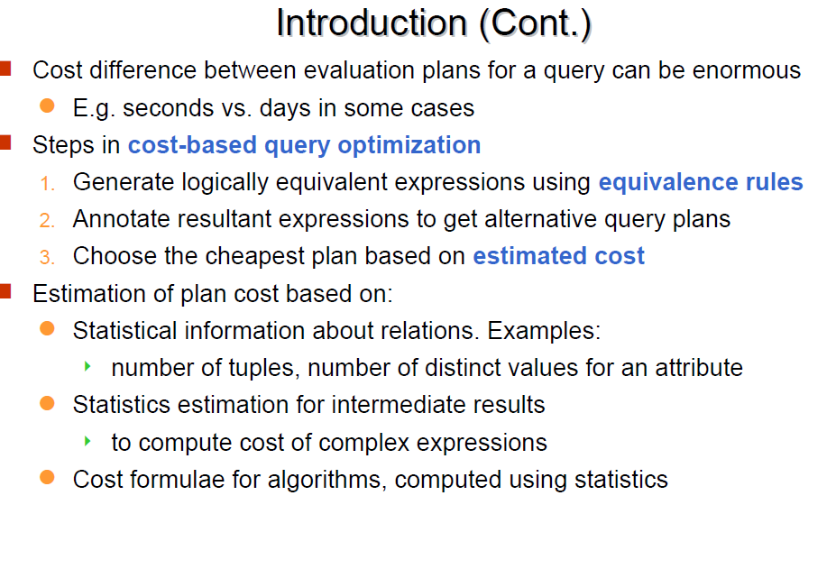

Slide 37
Generating Equivalent Expressions

Slide 38
Transformation of Relational Expressions
Two relational algebra expressions are said to be equivalent if the two expressions generate the same set of tuples on every legal database instance
  Note: order of tuples is irrelevant
  we don’t care if they generate different results on databases that violate integrity constraints
In SQL, inputs and outputs are multisets of tuples
  Two expressions in the multiset version of the relational algebra are said to be equivalent if the two expressions generate the same multiset of tuples on every legal database instance.
An equivalence rule says that expressions of two forms are equivalent
  Can replace expression of first form by second, or vice versa

Slide 39



Equivalence Rules
1. Conjunctive selection operations can be deconstructed into a sequence of individual selections.
2. Selection operations are commutative
3. Only the last in a sequence of projection operations is needed, the others can be omitted.
Selections can be combined with Cartesian products and theta joins.
  σ_{θ}(E₁ X E₂) = E₁ _{θ} E₂
  σ_{θ1}(E₁ _{θ2} E₂) = E₁ _{θ1∧ θ2} E₂

Slide 40
Equivalence Rules (Cont.)
5. Theta-join operations (and natural joins) are commutative.
E_{1 θ} E₂ = E₂ _{θ} E₁
6.(a) Natural join operations are associative:
(E₁ E₂) E₃ = E₁ (E₂ E₃)
(b) Theta joins are associative in the following manner:
(E_{1 θ1} E₂) _{θ2∧ θ3} E₃ = E_{1 θ1∧ θ3} (E₂ _{θ2} E₃)
where θ₂ involves attributes from only E₂ and E₃.

Slide 41

Pictorial Depiction of Equivalence Rules

Slide 42
Equivalence Rules (Cont.)
7. The selection operation distributes over the theta join operation under the following two conditions:
(a) When all the attributes in θ₀ involve only the attributes of one
of the expressions (E₁) being joined.
σ_{θ0}(E₁ _{θ} E₂) = (σ_{θ0}(E₁)) _{θ} E₂
(b) When θ ₁ involves only the attributes of E₁ and θ₂ involves
only the attributes of E₂.
σ_{θ1}∧_{θ2} (E₁ _{θ} E₂) = (σ_{θ1}(E₁)) _{θ} (σ_{θ2} (E₂))

Slide 43
Equivalence Rules (Cont.)
8. The projection operation distributes over the theta join operation as follows:
(a) if θ involves only attributes from L₁ ∪ L₂:
(b) Consider a join E_{1 θ} E₂.
  Let L₁ and L₂ be sets of attributes from E₁ and E₂, respectively.
  Let L₃ be attributes of E₁ that are involved in join condition θ, but are not in L₁ ∪ L₂, and
  let L₄ be attributes of E₂ that are involved in join condition θ, but are not in L₁ ∪ L₂.
∏
(
E
E
)
=
(
∏
(
E
))
(
∏
(
E
))
L
1
∪
L
2
1
θ
2
L
1
1
θ
L
2
2
∏
(
E
E
)
=
∏
((
∏
(
E
))
(
∏
(
E
)))
L
1
∪
L
2
1
θ
2
L
1
∪
L
2
L
1
∪
L
3
1
θ
L
2
∪
L
4
2

Slide 44
Equivalence Rules (Cont.)
The set operations union and intersection are commutative
E₁ ∪ E₂ = E₂ ∪ E₁
E₁ ∩ E₂ = E₂ ∩ E₁
  (set difference is not commutative).
Set union and intersection are associative.
(E₁ ∪ E₂) ∪ E₃ = E₁ ∪ (E₂ ∪ E₃)
(E₁ ∩ E₂) ∩ E₃ = E₁ ∩ (E₂ ∩ E₃)
The selection operation distributes over ∪, ∩ and –.
σ_{θ} (E₁ – E₂) = σ_{θ} (E₁) – σ_{θ}(E₂)
and similarly for ∪ and ∩ in place of –
Also: σ_{θ} (E₁ – E₂) = σ_{θ}(E₁) – E₂
and similarly for ∩ in place of –, but not for ∪
12. The projection operation distributes over union
Π_{L}(E₁ ∪ E₂) = (Π_{L}(E₁)) ∪ (Π_{L}(E₂))

Slide 45
Exercise
Create equivalence rules involving
  The group by/aggregation operation
  Left outer join operation

Slide 46
Transformation Example: Pushing Selections
Query: Find the names of all instructors in the Music department, along with the titles of the courses that they teach
  Π_{name, title}(σ_{dept_name= “Music”}
  (instructor (teaches Π_{course_id, title} (course))))
Transformation using rule 7a.
  Π_{name, title}((σ_{dept_name= “Music”}(instructor))
  (teaches Π_{course_id, title} (course)))
Performing the selection as early as possible reduces the size of the relation to be joined.

Slide 47
Example with Multiple Transformations
Query: Find the names of all instructors in the Music department who have taught a course in 2009, along with the titles of the courses that they taught
  Π_{name, title}(σ_{dept_name= “Music”∧year = 2009}
  (instructor (teaches Π_{course_id, title} (course))))
Transformation using join associatively (Rule 6a):
  Π_{name, title}(σ_{dept_name= “Music”∧gear = 2009}
  ((instructor teaches) Π_{course_id, title} (course)))
Second form provides an opportunity to apply the “perform selections early” rule, resulting in the subexpression
σ_{dept_name = “Music”} (instructor) σ _{year = 2009} (teaches)

Slide 48

Multiple Transformations (Cont.)

Slide 49
Transformation Example: Pushing Projections
Consider: Π_{name, title}(σ_{dept_name= “Music”} (instructor) teaches)
Π_{course_id, title} (course))))
When we compute
(σ_{dept_name = “Music”} (instructor teaches)
we obtain a relation whose schema is:
(ID, name, dept_name, salary, course_id, sec_id, semester, year)
Push projections using equivalence rules 8a and 8b; eliminate unneeded attributes from intermediate results to get:
Π_{name, title}(Π_{name, course_id} (
σ_{dept_name= “Music”} (instructor) teaches))
Π_{course_id, title} (course))))
Performing the projection as early as possible reduces the size of the relation to be joined.

Slide 50
Join Ordering Example
For all relations r_{1,} r_{2,} and r₃,
(r₁ r₂) r₃ = r₁ (r₂ r₃ )
(Join Associativity)
If r₂ r₃ is quite large and r₁ r₂ is small, we choose
(r₁ r₂) r₃
so that we compute and store a smaller temporary relation.

Slide 51
Join Ordering Example (Cont.)
Consider the expression
Π_{name, title}(σ_{dept_name= “Music”} (instructor) teaches)
Π_{course_id, title} (course))))
Could compute teaches Π_{course_id, title} (course) first, and join result with
σ_{dept_name= “Music”} (instructor)
but the result of the first join is likely to be a large relation.
Only a small fraction of the university’s instructors are likely to be from the Music department
  it is better to compute
σ_{dept_name= “Music”} (instructor) teaches
first.

Slide 52
Enumeration of Equivalent Expressions
Query optimizers use equivalence rules to systematically generate expressions equivalent to the given expression
Can generate all equivalent expressions as follows:
  Repeat
    apply all applicable equivalence rules on every subexpression of every equivalent expression found so far
    add newly generated expressions to the set of equivalent expressions
    Until no new equivalent expressions are generated above
The above approach is very expensive in space and time
  Two approaches
    Optimized plan generation based on transformation rules
    Special case approach for queries with only selections, projections and joins

Slide 53
Implementing Transformation Based Optimization
Space requirements reduced by sharing common sub-expressions:
  when E1 is generated from E2 by an equivalence rule, usually only the top level of the two are different, subtrees below are the same and can be shared using pointers
    E.g. when applying join commutativity
  Same sub-expression may get generated multiple times
    Detect duplicate sub-expressions and share one copy
Time requirements are reduced by not generating all expressions
  Dynamic programming
    We will study only the special case of dynamic programming for join order optimization
E1
E2

Slide 54
Cost Estimation
Cost of each operator computed
  Need statistics of input relations
    E.g. number of tuples, sizes of tuples
Inputs can be results of sub-expressions
  Need to estimate statistics of expression results
  To do so, we require additional statistics
    E.g. number of distinct values for an attribute
More on cost estimation later

Slide 55
Choice of Evaluation Plans
Must consider the interaction of evaluation techniques when choosing evaluation plans
  choosing the cheapest algorithm for each operation independently may not yield best overall algorithm. E.g.
    merge-join may be costlier than hash-join, but may provide a sorted output which reduces the cost for an outer level aggregation.
    nested-loop join may provide opportunity for pipelining
Practical query optimizers incorporate elements of the following two broad approaches:
  1. Search all the plans and choose the best plan in a
  cost-based fashion.
  2. Uses heuristics to choose a plan.

Slide 56
Cost-Based Optimization
Consider finding the best join-order for r₁ r₂ . . . r_{n}.
There are (2(n – 1))!/(n – 1)! different join orders for above expression. With n = 7, the number is 665280, with n = 10, the number is greater than 176 billion!
No need to generate all the join orders. Using dynamic programming, the least-cost join order for any subset of
{r₁, r₂, . . . r_{n}} is computed only once and stored for future use.

Slide 57
Dynamic Programming in Optimization
To find best join tree for a set of n relations:
  To find best plan for a set S of n relations, consider all possible plans of the form: S₁ (S – S₁) where S₁ is any non-empty subset of S.
  Recursively compute costs for joining subsets of S to find the cost of each plan. Choose the cheapest of the 2^{n} – 2 alternatives.
  Base case for recursion: single relation access plan
    Apply all selections on R_{i} using best choice of indices on R_{i}
  When plan for any subset is computed, store it and reuse it when it is required again, instead of recomputing it
    Dynamic programming

Slide 58
Query Tree Estimating Access Cost
Estimating Access Cost
Access cost-number of blocks brought into main memory for reading or written to secondary storage as result
Tables may be stored in packed form-blocks contain only tuples from one table unpacked form, tuples are interspersed with tuples from other tables
If unpacked, have to assume every tuple of relation is in a different block
If packed, estimate the number of blocks from tuple size, number of tuples, and capacity of the block
Some useful symbols:
t(R), number of tuples in relation R
b(R), number of blocks needed to store R
bf(R), number of tuples of R per block, called the blocking factor of R
If R is packed, then b(R) = t(R) / bf(R)

Slide 59
Example:
t(R), number of tuples in relation R
b(R), number of blocks needed to store R
bf(R), number of tuples of R per block, called the blocking factor of R
If R is packed, then b(R) = t(R) / bf(R)
If the Student relation has blocks of 4K bytes, and there are
  t(Student)=10,000 student records each 200 bytes long,
  then bf(Student)=20 records fit per block (4096/200).
We need 10000/20 or b(Student)=500 blocks to hold this file in packed form.
For the query and optimized version, let's assume the following sizes:
b(Student) = 500, t(Student) = 10000
b(Enroll) = 1250, t(Enroll) = 250,000 (average of 25 enrolled classes per student, 40-50 complete a 4 year degree), 250000 * 20 bytes / 4000 = 1250
b(Class) = 125, t(Class) = 1000 , 1000* 500 bytes / 4000 = 125
A join requires roughly the product of the block counts.

Slide 60
Unoptimized
Student X Enroll = 500*1250 = 625,000 block accesses to do this join.
The result set, however, would be 10,000 students * 25 classes * 220 bytes /4000= 13,750 blocks.
(Std X Enroll) X Class = 13,750 X 125 = 1,718,750 block accesses. Result set should be same number of tuples 250,000 * 720 bytes / 4000 = 45,000 blocks
Now read the 45,000 blocks to select the Math majors (say 400?) --> result set is 400*720 / 4000 = 72 blocks. Then read again for projection
625,000+ 1,718,750+45,000 = 2,388,750 blocks read
Optimized
Student select Math majors, read 500 blocks and get 400*200 bytes/ 4000 or 20 blocks
Join (MathStudents X Enroll) = 20 X 125 = 2500 blocks accessed, result is 400 * 25 *220 /4000 = 550 blocks
Join with Class = 550 X 125 = 68,750 block aecesses. result set is 400 * 720 / 4000 = 72 blocks, then the projection
500 + 2500 + 68,750 = 71,750 blocks read prior to projection
Bottom line
Prior to joins, use select and maybe projects to reduce the amount of blocks that need to participate in the join

Slide 61
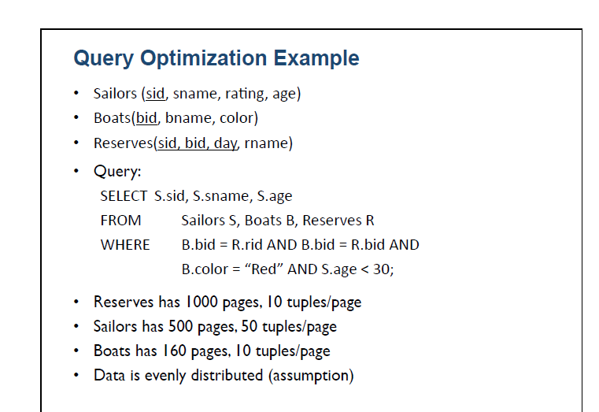

Slide 63
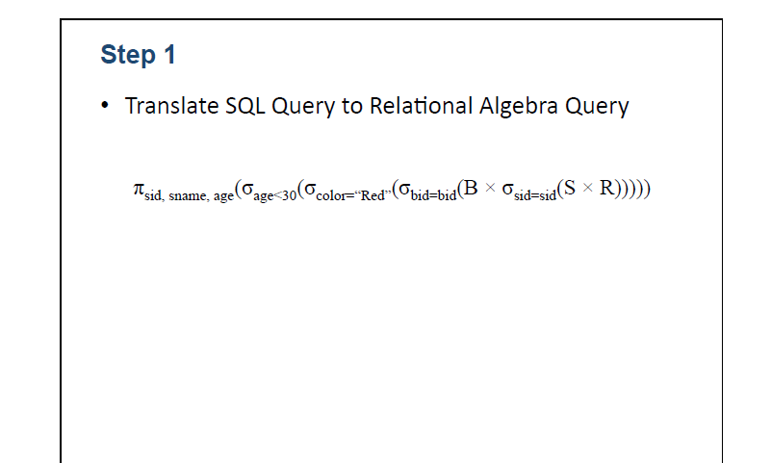

Slide 64
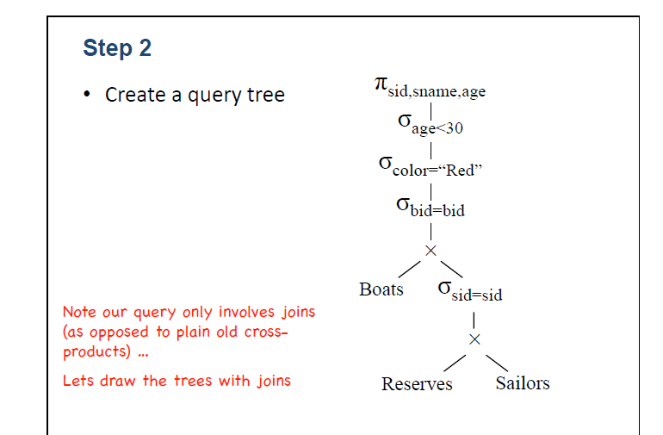

Slide 65
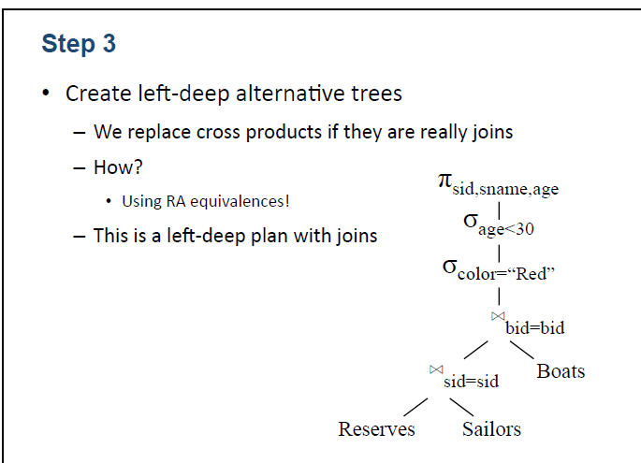

Slide 66
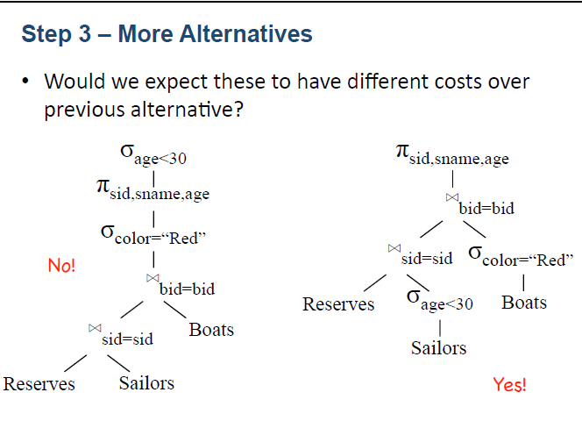

Slide 67
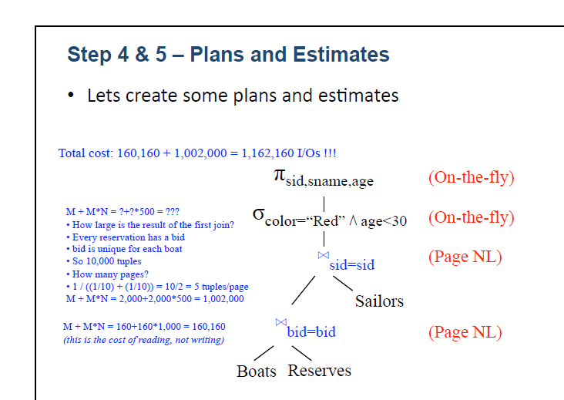

Slide 68
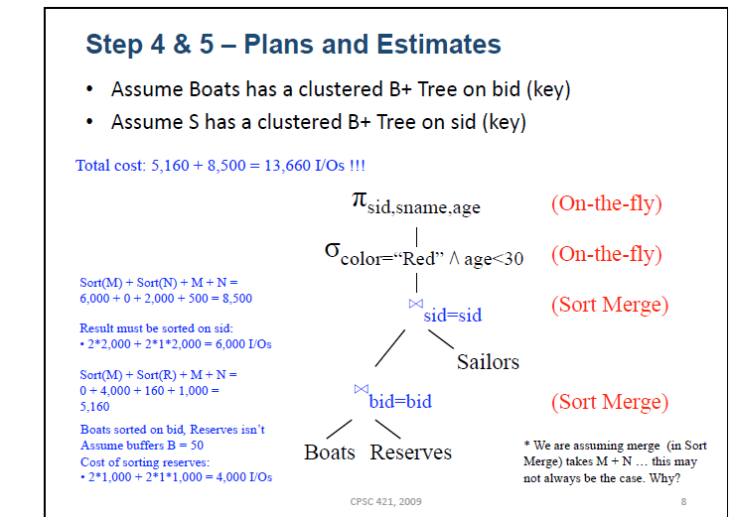

Slide 69
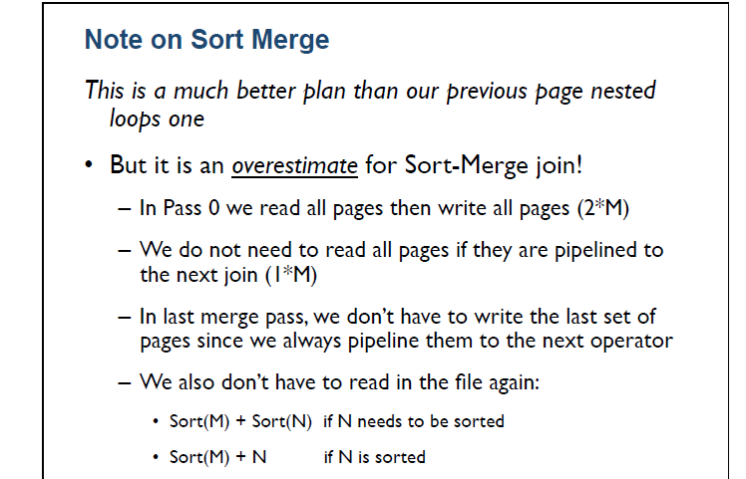

Slide 70
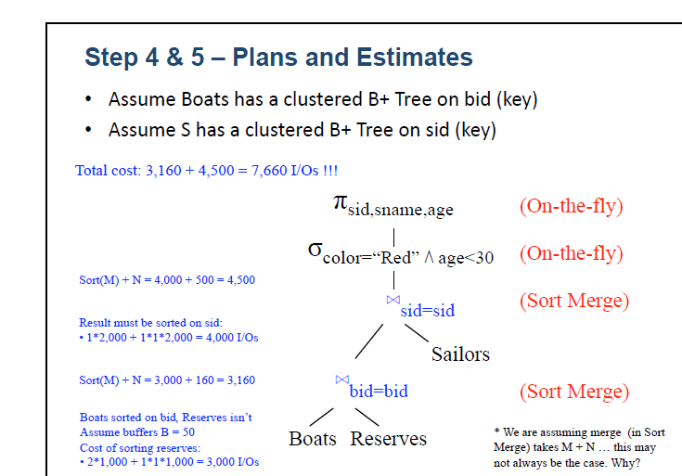

Slide 71
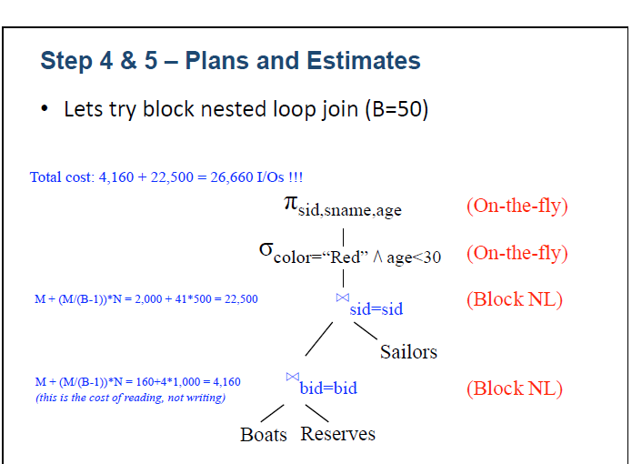

Slide 72
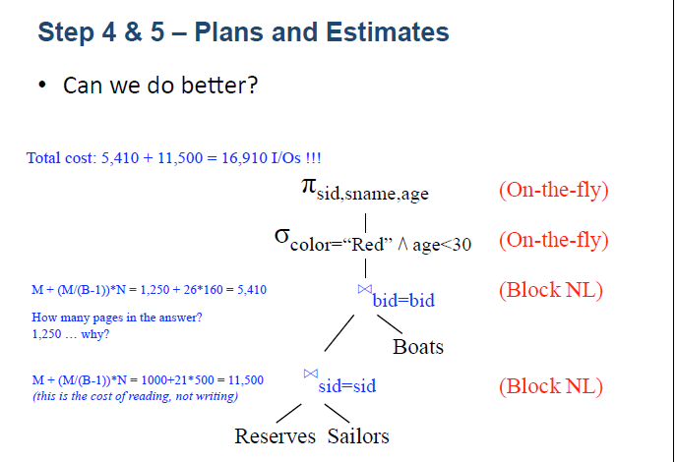

Slide 73
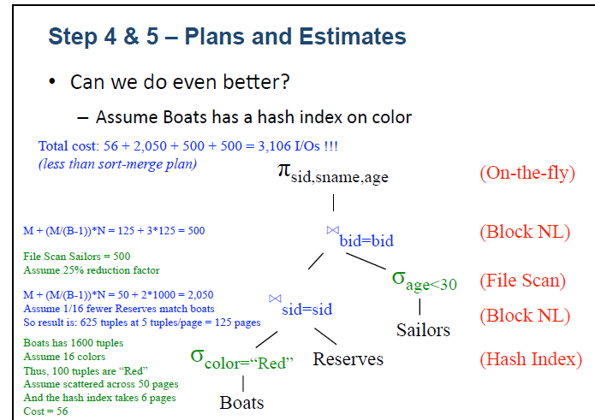

Slide 74
